Slide 1
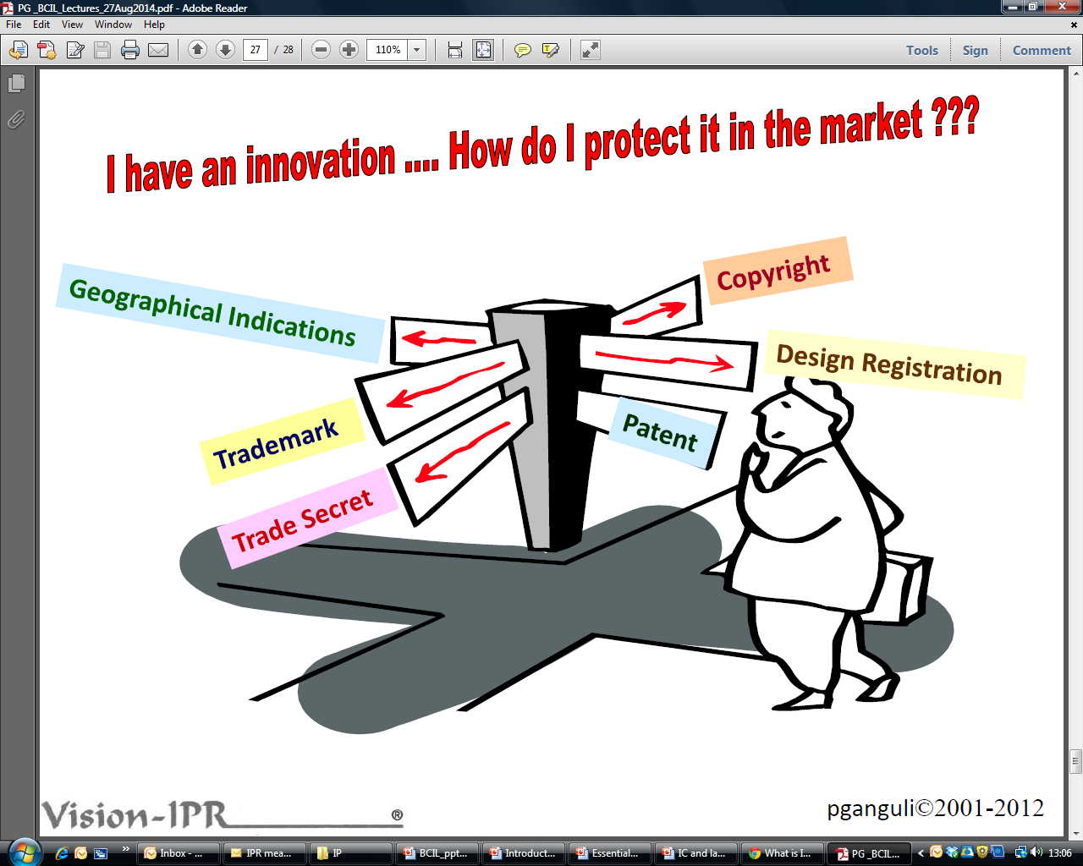
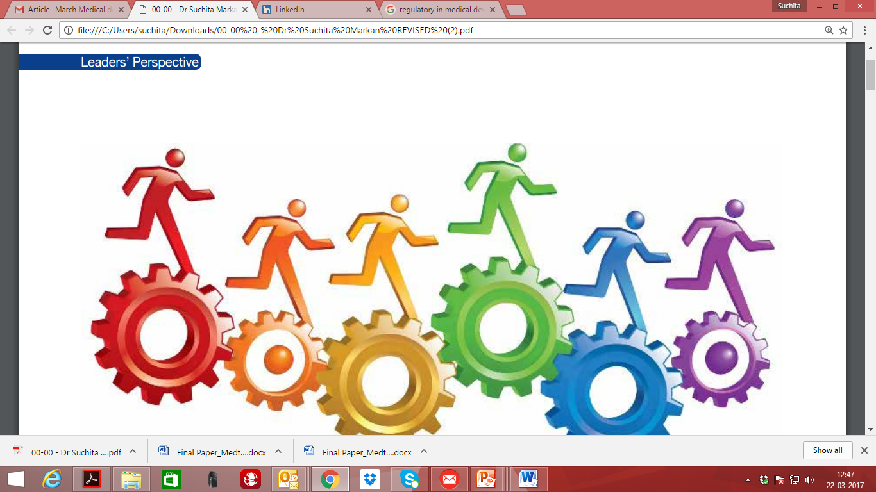




“Intellectual property”

Slide 2

INTELLECTUAL PROPERTY
The term ‘intellectual property’ (IP) refers to property created with the use of human intellect.
IP refers to all creations of mind which are vested with the status of property because of the commercial value associated with the intellectual creation. i.e. inventions in all fields of human endeavor, scientific discoveries, industrial designs for article, literary & artistic work, symbols etc. used in commerce.
Nature/ characteristics of Intellectual Property:
Creation of human mind (Intellect)
Intangible property
Exclusive rights given by statutes( a written law)
Time-bound and Territorial/Jurisdictional
Notes:
The domain of intellectual property is vast.
Copyrights, Patents Trademarks and Designs are
known to have received recognition for a long time.
Newer forms of the protection are also emerging
particularly stimulated by the exciting developments
in scientific and technological activities.
Generally, it encompasses four separate and
distinct types of intangible property namely — patents, trademarks, copyrights, and trade secrets, which
collectively are referred to as “intellectual property.” However, the scope and definition of intellectual property
is constantly evolving with the inclusion of newer forms under the gambit of intellectual property. In recent
times, geographical indications, protection of plant varieties, protection for semi-conductors and integrated
circuits, and undisclosed information have been brought under the umbrella of intellectual property.

Slide 3
What is Intellectual Property Right (IPR)?
Intellectual Property Right
not to be confused with IP
it is a right vested in the asset, not the asset itself
e.g.
an idea / invention is IP, a patent registration is an IPR
a customer / price list is IP, a right of confidentiality is an IPR
a secret production method is IP, a right to a trade secret is an IPR
a particular way of representation is IP, copyright or a design registration is an IPR
a brand / trade name is IP, a trade mark registration is an IPR
Notes:
IPR are Affirmative Rights, NOT Protection
Allows owner to file a lawsuit against a transgressor
Does not stop a transgressor

Slide 4
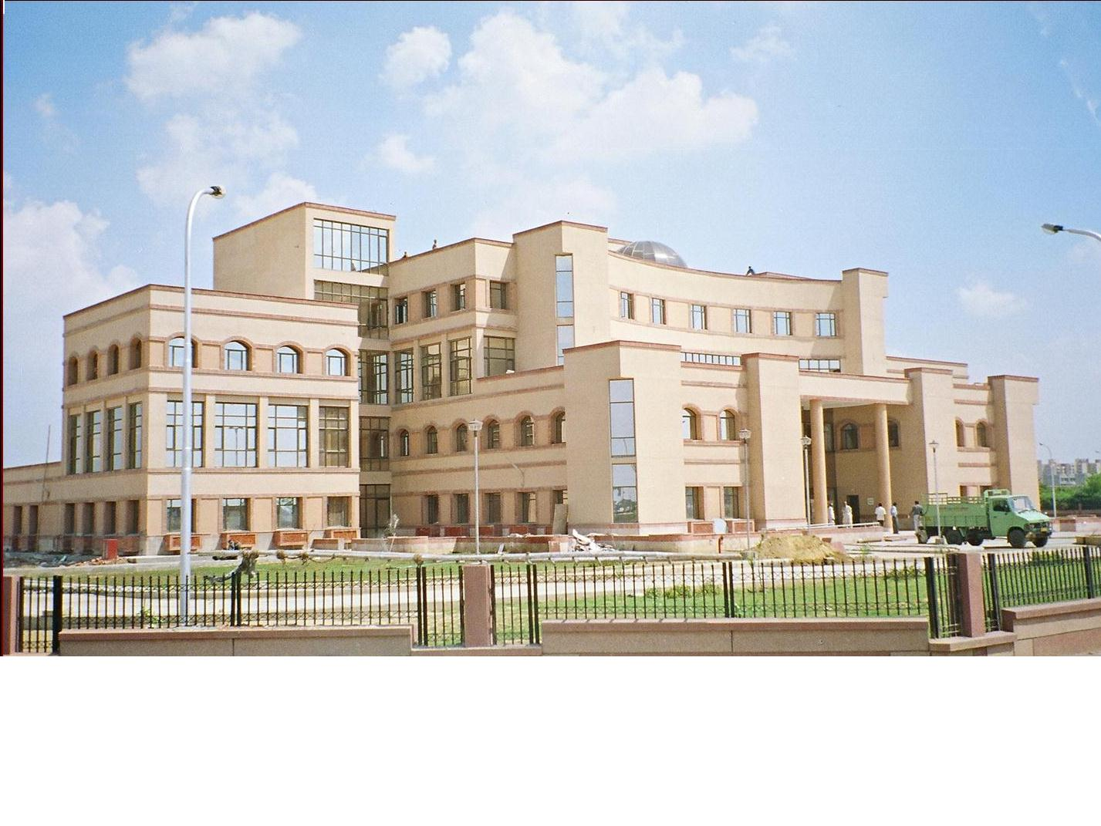

Intellectual property in India
INDUSTRIAL PROPERTY
+
COPY RIGHT
PATENTS
DESIGNS
TRADEMARKS
Geographical Indications
Patents & Designs
Patent Information
P I S
P A T E N T O F F I C E
T r a d e M a r k s R e g i s t r y
GOVERNMENT OF INDIA
Trade Marks
C o p y r i g h t o f f i c e
Copy Right
GIR
Geographical Indications

Slide 5
INDUSTRIAL PROPERTY
Patents | Designs | Trade- Marks | Geographical Indications
Inventions relating to constructional features | any modification in shape,pattern, configuration | Word Name Logo | Indications of source origin or geography
e.g. Safety Valve, Mechanism of a PRESSURE COOKER | e.g. shape of a handle or body portion of a pressure cooker | e.g. for same Pressure Cooker “PRESTIGE” “HAWKINS” “MAHARAJA” | Darjeeling tea Kanchipuram sarees KolhapurI chappals

Slide 6



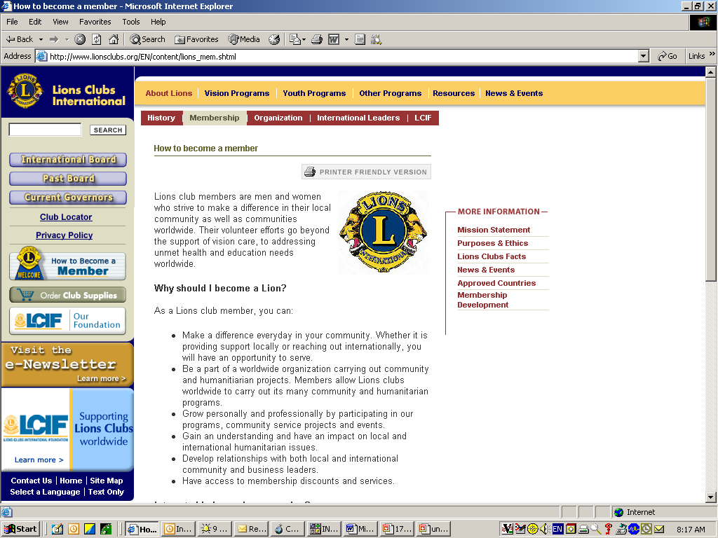
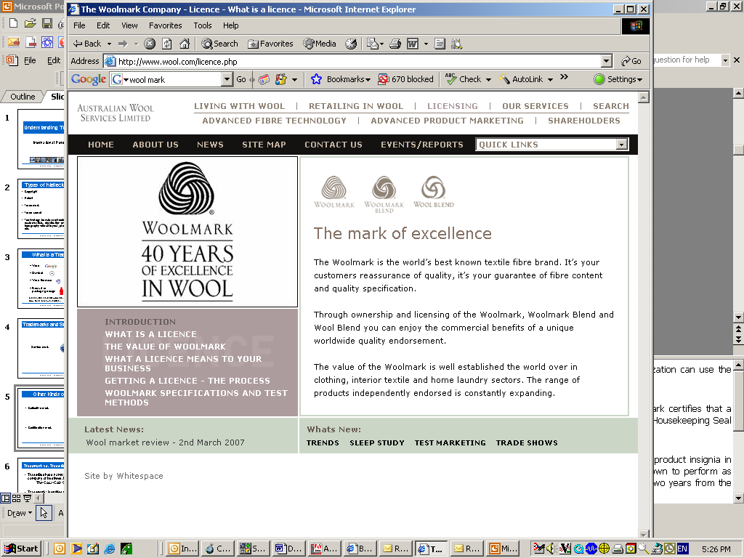



‘Trade Mark’ – Definition under the Trade Marks Act 1999
Trade mark means, a mark capable of being represented graphically and which is capable of distinguishing the goods or services of one person from those of others and may include shape of goods, their packaging and combination of colures….
"mark" includes a device, brand, heading, label, ticket, name, signature, word, letter, numeral, shape of goods, packaging or combination of colours or any combination thereof;
[S. 2 (1) (zb) Trade Marks Act 1999]
JUST DO IT.

Slide 7
Notice of Registration
®
______ is a trademark/service mark of _______
TM
SM
Notes:
Many countries have adopted the ® (alternatively called the R-in-a-circle, Circle-R or Encircled R, or registration symbol) as the notation used to advise the public that the mark has been registered. (Other notations, such as "Registered in the U.S. Patent and Trademark Office" or “Marca Registrada,” are also used in various countries.) In a few countries, such as China, marking is mandatory; in most, it is permissive. The registration notice can be used only with registered marks. Use of ® with any unregistered trademark may result in claims of fraud, misleading advertising or criminal penalties in some countries. Once a registration issues, it is important to use the ® symbol to place the public on notice that the mark is a registered protected intellectual property right. Failure to use the ® symbol can permit a defendant in an infringement action to argue that he/she/it did not know that the word or symbol was protected.
Instead of a notation, a “legend,” caption or footnote stating that “X is a trademark/service mark of Company A” can be used in the packaging, labels or other materials.
™ represents a claimed registered or unregistered trademark. It is an informal notification that there is a public claim as a trademark.
SM represents a claimed registered or unregistered service mark. Similar to ™, it is an informal notification that there is a public claim as a service mark.

Slide 8
Purpose & functions of a Trademark
To identify the origin of the product/service.
To distinguish the product/service of the proprietor from those of others.
To guarantee the quality of the product/service, and
To advertise the product/service.

Slide 9
Selecting a Mark
Distinctiveness Spectrum
The more distinctive the mark, the greater its level of legal protectability. Generic marks are not capable of trademark protection. Descriptive marks are capable of protection only with a showing of secondary meaning.
Notes:
In selecting a mark, companies frequently select a word that is “catchy” and describes a characteristic of the goods or services. The more descriptive the mark, the less protection it provides; this means that other parties may be free to use descriptive words to advertise competitive products. (Examples: SINGAPORE; UNITED AIRLINES.) Conversely, the less descriptive the mark, the greater the chances of exclusive protection for the mark.
The categories of distinctiveness, ranked in terms of strength from greatest to weakest, are as follows:
(a) Fanciful Marks: created from words that are coined or made up and that have no meaning in relation to the goods or services with which they are used. (Examples: HÄAGEN-DAZS for ice cream; EXXON for petroleum products.)
(b) Arbitrary Marks: created from existing words but have no meaning in relation to the goods or services. Fanciful and arbitrary marks are easier to protect but can be more expensive to promote. (Examples: APPLE for computers; TIDE for detergent.)
(c) Suggestive Marks: suggest, rather than describe, the goods or services or some characteristic thereof. The consumer must use imagination to understand the connection. (Examples: COPPERTONE for suntan oil; BURGER KING for quick-service burger restaurants.) Although suggestive marks are self-advertisers and, thus, easier to promote than arbitrary marks, they are subject to more conflict and may be afforded a narrower scope of protection.
(d) Descriptive Marks: describe either the goods or services or a characteristic or quality thereof. (Example: AMERICAN AIRLINES for airline services.) Included in this group are (1) laudatory words that attribute superiority to the goods (e.g., GOLD MEDAL and SUPREME), (2) geographic terms and (3) surnames. They are difficult to enforce unless the owner can show that the mark has become distinctive as applied to the goods or services.
(e) Generic Terms: consist of the common name of the goods or services to which they are applied. They are not capable of acquiring secondary meaning when used in their generic sense, and, thus, are not protectable as marks when so used. (Examples: computer, automobile, shuttle.)

Slide 10
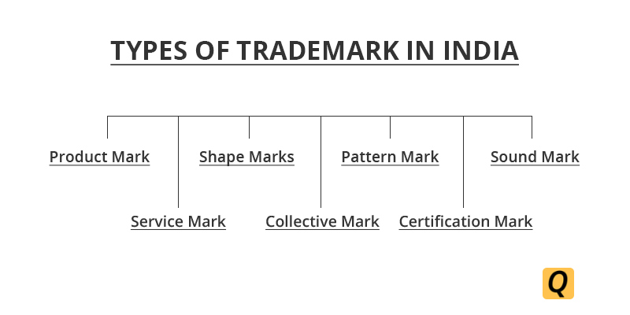

Slide 11

Product Mark
A product mark is similar to trademark only, but it is to identify the products or goods instead of services. Herein the product is the unique selling feature of the company. Initially, TM, which states that the mark is not yet registered. Once they are registered, they have to use ®.
Examples: Pepsi®, Maggi®, PHILIPS® etc.

Slide 12

Service Mark
This type of trademark is used to identify and distinguish the services rather than the products.
Like intangible products , transport, communication or other utilities such as electricity, water, routine maintenance or repair work, etc.
The Service marks have their particular symbol which is SM and not TM.

Slide 13
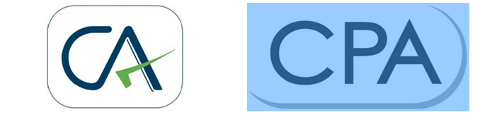
Collective Mark
A collective mark is owned by a collective, whose members use the collective mark to identify their goods and services and to distinguish their goods and services from those of non-members, and to indicate membership in the group.
Examples are like "CA" device is used by the members who fall under Institute of Chartered Accountants; another example is "CPA" which denotes members of the Society of Certified Public Accountants.

Slide 14


Certification marks
Certification marks are used to define "standard" of goods and services.
Example: Woolmark, which is certified for the fabrics on clothing, Agmark, and ISI.

Slide 15

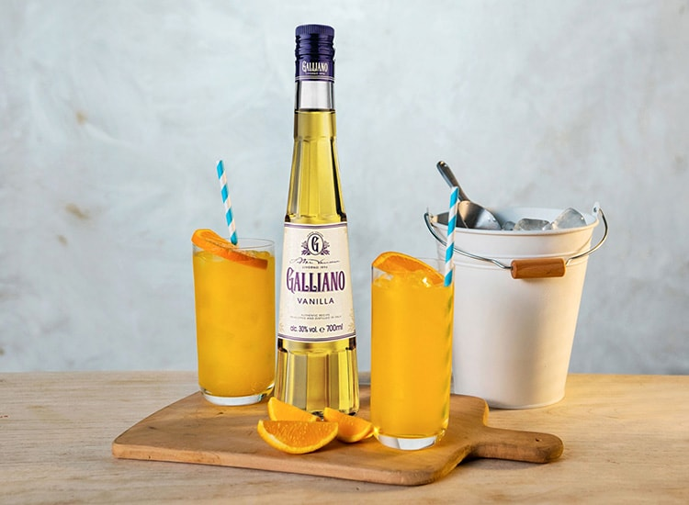
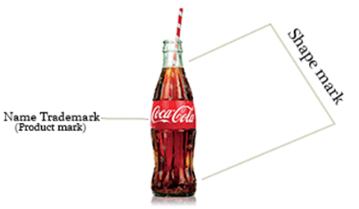
Shape Marks
To sum up shape trademarks, it has facilitated promotion of products and emerged into the trademark type after the technological advancement of graphics and other forms of animation technology. The graphical representation which is able to make a difference amongst the products can be shape marked. An example can be the Galliano liquor bottle.
Notes:
Shape marks
These marks can also be categorized in Trade Dress wherein, other than the logo, label, and other identifiable symbols; a product can also be distinguished based on its packaging. An example can be the Galliano liquor bottle.
By shape, it means the 3-D marks which are capable of making a difference in the goods and services of one businessman from another. There is a new Trade Marks Ordinance (Cap.559) which permits registration of such marks.
​
The above image will help you understand the basic difference between Shape Marks and all other trademark types.
To give you a more clear idea this is an example of shape mark which the Mogen David wine bottle has registered for serving wine bottles: This is specifically known as trade dress and the uniqueness can be protected under principles of trademark.
The competitors however intended to create confusion by labelling similar bottles but Mogen David was able to stop them and revive its original distinctive nature to use it as a trademark in the market.
To sum up shape trademarks, it has facilitated promotion of products and emerged into the trademark type after the technological advancement of graphics and other forms of animation technology. The graphical representation which is able to make a difference amongst the products can be shape marked.

Slide 16
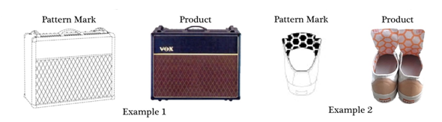
Pattern Mark
The general meaning of pattern is a repetition of similar design, so it is a type of trademark wherein the pattern is able to distinguish the product and services of one brand from another. These are difficult to be distinguished and have high chances of infringement with near similar designs.
They at times, fail to make a distinction and the registration would not be accepted unless they have evidence of distinctiveness.
Notes:
Pattern Mark
The general meaning of pattern is a repetition of similar design, so it is a type of trademark wherein the pattern is able to distinguish the product and services of one brand from another. These are difficult to be distinguished and have high chances of infringement with near similar designs.
They at times, fail to make a distinction and the registration would not be accepted unless they have evidence of distinctiveness.
A repeating pattern mark is any mark that is composed of a single element repeated to form a combination of designs, numbers, letters, or other characters, forming a complete pattern that is displayed on goods, on product packaging, the pattern can also be associated with the material, advertising or provision of services.
Read: How to Avoid Trademark Infringement
In a repeating pattern mark, the repeating pattern/element is to be mentioned specifically in the application for registering the trademark for avoiding any confusion.
There are chances the pattern mark can be rejected based on the below-written reasons:
Common or Widely Used Pattern
Pattern Creates a Distinct Commercial Impression Apart from Other Matter
Nature of Elements in the Repeating Pattern
Industry Practice
It can be rejected because the mark fails to function as a source indicator.

Slide 17
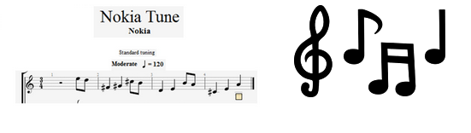
Sound Mark
The sound graphics that distinguish the products and services of one from the other.
The sound logo can comprise musical notes, words and sound graphics. The first Sound Mark to be registered in India was Yahoo yodel followed by Nokia tune.
Notes:
Sound Mark
There has been an introduction of another form of trademark where the "mark" is of sound graphics that distinguish the products and services of one from the other. Only those notations of sound that are graphically represented can be registered as trademarks. Sound marks being audio form of trademark is challenging but to figure out the accurate nature of the sound mark based on its registration, there needs clarity in graphical representation of the sound design.
The sound logo can comprise musical notes, words and sound graphics. The first Sound Mark to be registered in India was Yahoo yodel followed by Nokia tune.

Slide 18
Loss of Rights
Improper use • Failure to police
Genericide • Failure to renew
Non-use • Cancellation
Improper assignment or licensing
Notes:
Trademark rights may be lost through improper use, such as when the owner allows the mark to become the generic term for the product itself, a process known as “genericide.” Other instances in which trademark rights may be lost include:
• Non-use for an extended time, with insufficient steps taken to resume use.
Improper assignment (failure to transfer goodwill).
Improper licensing (failure to exercise quality control).
Failure to police unauthorized use of the mark or infringing marks by the media and others. Some companies use advertisements to educate the public that a certain brand is not a synonym for a product or service. Another strategy is to write letters to journalists and editors of professional publications and dictionaries and notify them that certain designations are trademarks and to advise them on the proper way to refer to a trademark.
Failure to renew or comply with registered user requirements for registrations.

Slide 19
Benefits of Registration of a trademark
Registration is prima facie evidence of proprietorship of the trademark
It gives the exclusive right to use the trademark in respect of goods/services; and to take legal action in case of infringement
The registered proprietor may assign or license the trademark as any other property
The registered proprietor can enjoy the Goodwill associated with registered trademark forever, if the mark is renewed from time to time

Slide 20
Steps for registration of trademark in India
Select a good trademark
Apply for registration on appropriate form with appropriate fee
Classify your goods & services and specify them properly
Apply before appropriate office of the Trade Marks Registry; and
Respond to office queries/notices properly and on time

Slide 21
Selecting a good Trademark
Go for a trademark which is-
Easy to speak & spell (in case of word mark),
Appealing and easy to remember or recollect.
invented or coined word, unique monogram, logo or a geometrical device
Don’t go for a trademark -
Which is not capable of distinguishing your goods or services from those of others- like one/two digit letters or numerals, common surnames/ names, words or pictures of the product concerned, etc. …………………………..[Section 9(1)(a)]
Which refers to character or quality of goods/services concerned, which indicate geographical origin, which are common to trade,..[Section 9(1) (b) & (c)]
a deceptive, scandalous or offensive matter or a matter prohibited by law to be used as a trademark,………………………………………………………………….[Sections 9(2)(3) & 13 ]
a mark which is same/similar to an already existing trademark,…[Section 11]

Slide 22
Appropriate form and fee
At present there are many forms prescribed for filing new applications depending on the nature of application such as Form TM-1, TM-2, TM-51, TM-52 TM-3, TM-8 etc.
Fee ordinarily Rs.4000/-per class
[In the proposed revised rules there will be only one form for all types of applications for registration of trademarks.]

Slide 23
Steps involved in registration process
Receipt of applications, data entry & digitization
[at Branch Offices]
In case of objections Response by applicant-
Consideration of response
[centralized]
Objections not waived after Response-
Show Cause Hearing
[at Branch Offices]
Examination of applications, approval by Supervisors, release of ERs
[centrally at TMR Mumbai]
In case, there are no objections/objections waived -
Publication in the Trade Marks Journal
Objections not waived-
Application refused
In case of opposition, opposition proceeding [at Branch office]
No opposition/opposition decided in favor of the applicant-
Application proceeds to registration
Appeal may be made before IPAB,
Opposition allowed- application refused

Slide 24
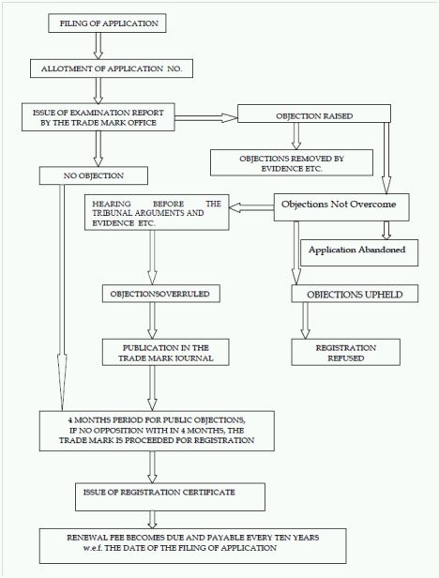
Steps involved in registration process

Slide 25
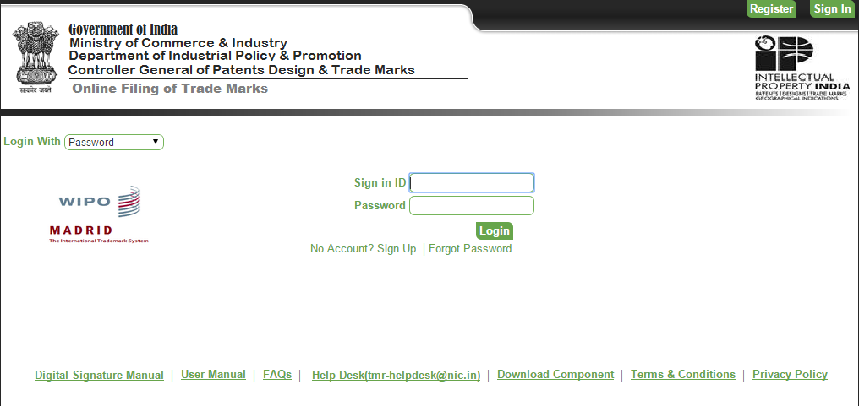

Slide 26
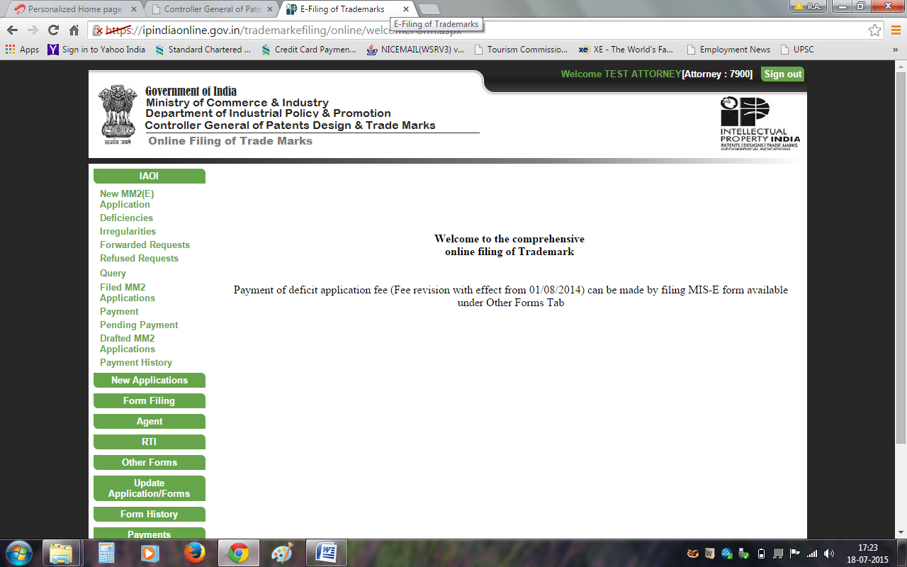

Slide 27
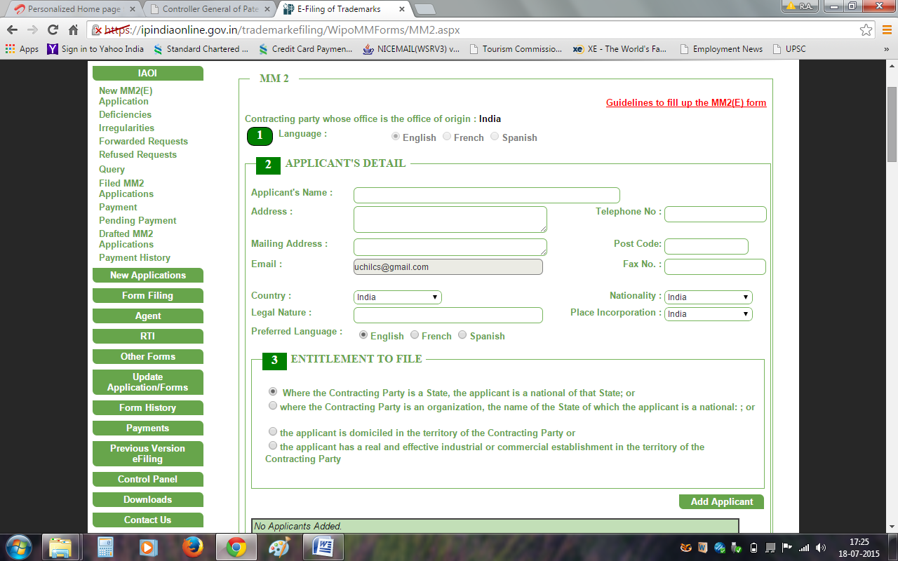

Slide 28

Got an Inventive Idea?
If you have an invention or inventive idea
What do you do?
Publish a Paper
Start Manufacturing
Protect your invention
Apply for Patent

Slide 29
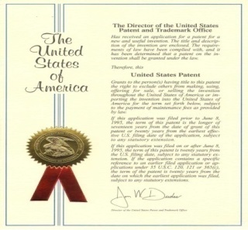
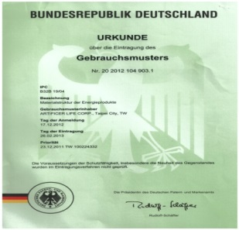


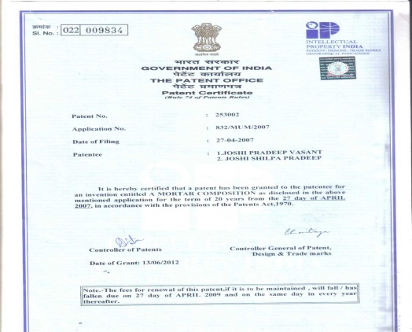
Patent
A patent is a statutory grant by Govt for new inventions conferring certain monopoly rights on the grantee for a defined period, subject to certain conditions ie Exclusive rights given to a person in return for a full and complete disclosure of the invention for which the patent is claimed
Patent rights are territorial
Term: 20 years from date of filing
Aim
Encourage industrial development
Encourages complete disclosure
Prevents duplication
Focus on commercial relevance
Prevents exploitation of researchers
Revenue generation
Source of technical information

Slide 30
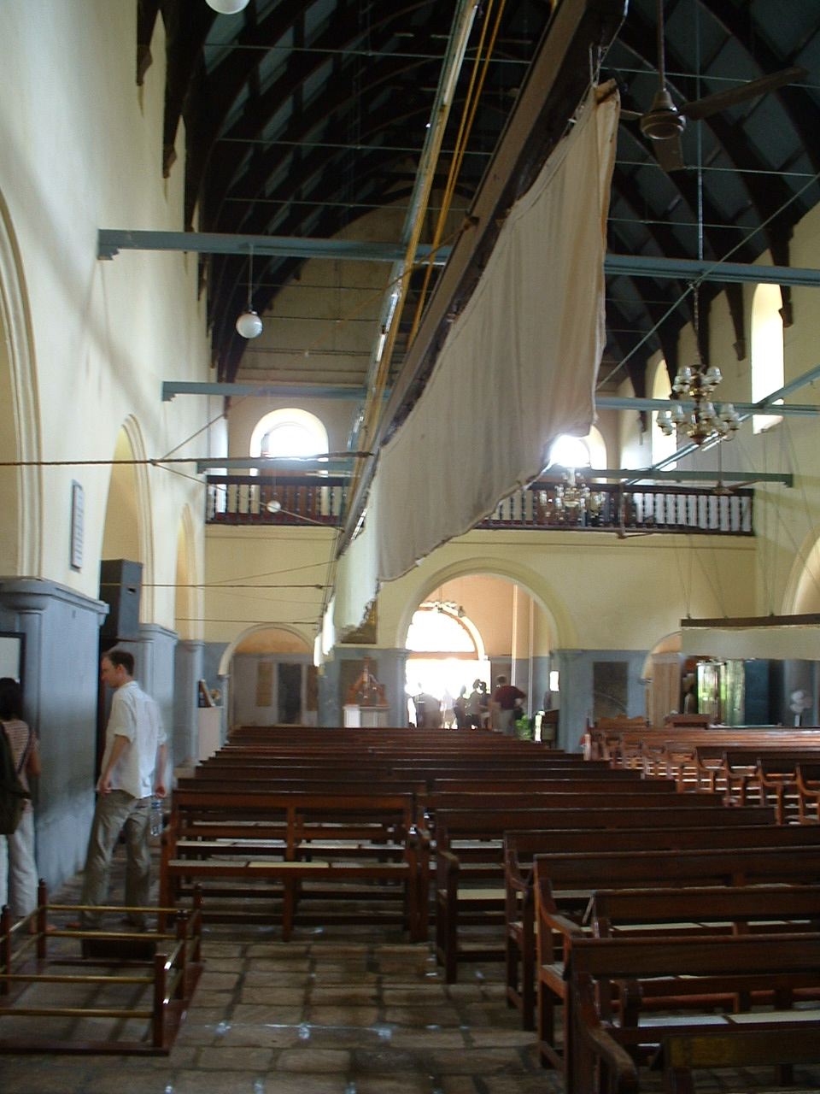
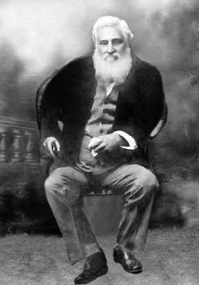
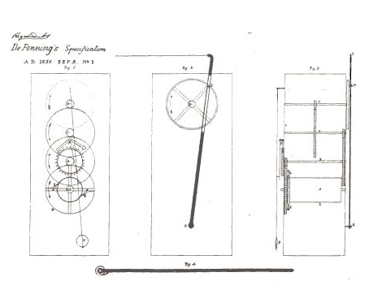
A punkah pulling machine (February 28, 1856)
George Alfred DePenning

Slide 31
What Can Be Patented
Process or Method
Machine or Apparatus
Article of Manufacture
Composition of Matter
Chemical Compounds
Physical Mixtures
Improvements of Any of the Above

Slide 32
Patentability Criteria
Industrial utility
Non-obviousness
Novel
Subject matter
Novel
No prior use/claim/ publication
Capable of being made or used in industry & reproduced with the same characteristics as many times as necessary
Subject matter
used
Should be non-obvious to a person skilled in the art
-Technical advancement
-Economic significance
“Any thing under the sun cannot be patentable”

Slide 33
Novelty
Novelty mean that the subject matter SHOULD NOT BE
PUBLISHED IN ANYWHERE IN THE WORLD PRIOR TO THE PATENT APPLICANT INVENTING IT
IN PRIOR PUBLIC KNOWLEDGE OR PRIOR PUBLIC, BUT NOT NECESSARILY PATENTED OR PUBLISHED
USE, SALE, MANUFACTURE, & DEVELOPED ANYWHERE IN THE WORLD
CLAIMED BEFORE IN A PATENT SPECIFICATION ANYWHERE IN THE WORLD
A Novel subject is not part of state of the art.
(state of the art comprise product, process, or information
in public domain)

Slide 34

Novelty Search
Novelty is determined before inventive step (or Non-obviousness) because the creative contribution of the inventor can be assessed only by knowing the novel elements of the invention
The Novelty Search is conducted to see whether the invention is anticipated by any prior art

Slide 35

What are Anticipations
Anticipation
Dictionary Meaning:
A prior action that takes into account or forestalls a later action
Visualization of a future event or state
Meaning w.r.t. to Patents:
Any description of the invention which destroys the element of novelty of the invention

Slide 36

Anticipation criteria to determine novelty
If it was available publicly before the priority date
Planting the flag test
Prior publication shall have clear and unmistakable direction to do what patentee claims to have invented
Sign post to invention is not enough
Prior inventor must be clearly shown to have planted his flag at precise destination and before the patentee

Slide 37
Doctrine of anticipation to determine novelty
35 U.S.C. 102 sets forth the doctrine of anticipation by requiring novelty of invention.
Doctrine of anticipation
“A claim is said to be “anticipated” if comparison of the claimed invention with a prior art reference reveals that each and every element in the claim under attack is shown or described, organized, and functioning in substantially the same manner as in the prior art reference”

Slide 38
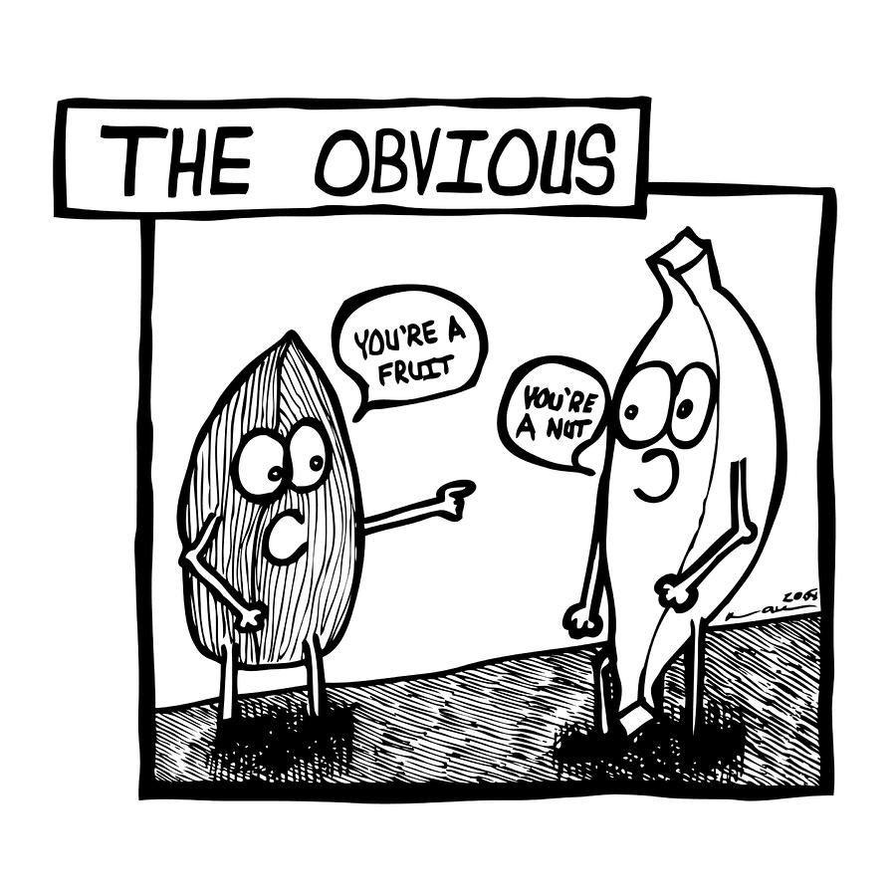
The Non-obviousness Requirement
Even if the invention demonstrate patentable subject matter, utility and novelty, the patent will not issue if the invention is obvious
“Obviousness is the next step in the road to patentability, and a significant hurdle”

Slide 39
The Non-obviousness Requirement
What is obviousness?
“An invention is obvious if the differences between the subject matter sought to be patented and the prior art are such that the subject matter as a whole would have been obvious at the time the invention was made to a person having ordinary skill in the art to which said subject matter pertains.”
Not exactly but rather known if one were to combine several references.
Obviousness defines predictable and non-unique combination of what multiple references teach would yield your invention.
Notes:
The current Examination Guidelines defines a person skilled in the art as follows. In determining non-obviousness of the invention, the Examination Guidelines, Part II, Section 2.2(2) prescribes that a person skilled in the art is a hypothetical person who has a common general knowledge in the art at the time of filing the application and ability to use ordinary technical means for research and development, can exercise ordinary creative ability in selecting materials and changing designs, is capable of comprehending all technical matters in the state of the art at the time of filing the application, and is capable of comprehending all technical matters in the field of technology relevant to the problem to be solved by the invention.
Thus, Examiner is not considered to be a person of ordinary skill in the art, but Examiner is supposed to carry out the examination taking the knowledge of such hypothetical person into consideration.

Slide 40
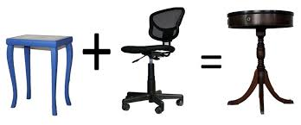
The Non-obviousness Requirement
Example:
When you have invented A+B.
A is known in the prior art, and B is known in the prior art.
Upon looking at A and then looking at B, would someone of skill in the art consider A+B to be already known?
If the answer is yes, then A+B is obvious.
If the answer is no, then A+B is not obvious.

Slide 41
Some more rules to determine obviousness
The differences between the prior art and challenged claims;
The level of ordinary skill in the field of the pertinent art at the time of plaintiff’s invention;
What one possessing that level of skill would have deemed to be obvious from the prior art reference;
Objective evidence of obviousness or non-obviousness;
Objective evidence includes: (1) the commercial success of the invention; (2) whether the invention satisfied a long felt need in the industry; (3) failure of others to find a solution to the problem at hand; and (4) unexpected results.

Slide 42
Determining what would have been obvious to a person of ordinary skill in the art
The decision maker may examine the following factors:
Type of problems encountered in the art;
Prior art solutions to those problem;
Rapidity with which innovations are made;
Sophistication of the technology;
Educational level of the inventor; and
Educational level of active workers in the field.

Slide 43

Subject Matter
The patents Act 1970 doesn't define the category of the inventions that can be patented
But provides a list of inventions that cannot be patented.
Idea behind preventing certain inventions from patentability is to prevent monopoly over inventions which are injurious to health, environment, morality, national defense & security.
NOT
PATENTABLE

Slide 44

Brief glace on different types of searches
Novelty Search
Patentability Analysis
Freedom to Operate Analysis
Landscape Analysis
Infringement Analysis
Validity/Invalidity Search

Slide 45
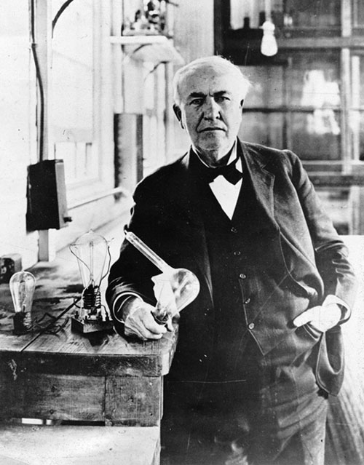
Application for patents
Who can file a patent?
Section 6: Persons entitled to apply for patents
True and first inventor of the invention
Assignee of true and first inventor
Legal Representative of a deceased person who immediately before his death was entitled to make such application
Application submitted either alone or jointly with other person.

Slide 46

Types of Applications
Ordinary Applications
Convention Application
Patent of Addition Application
Divisional Applications
PCT International Phase Application
PCT National Phase Application

Slide 47
Documents required for filing of A Patent Application
Application for Grant of Patent in Form 1 in duplicate
Complete/Provisional specification in Form 2 in duplicate
Statement and Undertaking in Form 3.
Power of Attorney in Form 26 (in original) ; (if filed through attorney)
Declaration of Inventor-ship in Form 5
Requisite Statutory fees (copy of the Priority cheque / DD).
Covering letter- indicating the list of documents

Slide 48
Contents of Specification
Title of the invention
Field of the invention
Background of the invention (PRIOR ART)
Object of the invention
Summary of the invention
Brief description of drawings, if any
Detailed description of the invention
Examples
Claims- not required in provisional
Abstract- not required in provisional

Slide 49
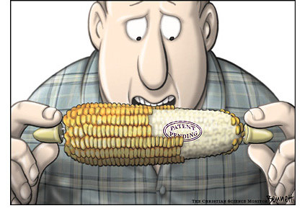
Types of Application
Provisional application
Get early priority
Not expensive
Quick
Title/Description
No claims
Cannot be filed in case of conventional/PCT/Divisional application
Filing provisional application is an optional but an advisable step

Slide 50

Types of Application
Complete specifications
Where an application for a patent is accompanied by a provisional specification, a complete specification shall be filed within twelve months from the date of filing of the application,. E.g.
Example
Provisional application: 01-12-2008
Complete specification: 01-12-2009

Slide 51
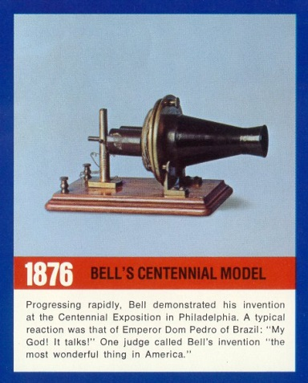
Types of Application
Section 10: Contents of specifications
Every specification shall start with a title sufficiently indicating subject matter.
Drawings
Model or sample illustrating the invention but such model or sample shall not be deemed to form part of the specification

Slide 52
Types of Application
Section 10: Contents of specifications (contd.)
Every complete specification shall—
fully and particularly describe the invention and its operation or use and the method by which it is to be performed;
disclose the best method of performing the invention which is known to the applicant and for which he is entitled to claim protection; and
end with a claim or claims defining the scope of the invention for which protection is claimed;
be accompanied by an abstract to provide technical information on the invention.

Slide 53
Stages from filing to grant of a patent

Slide 54
STAGES - FILING TO GRANT OF PATENT
FILING OF APPLICATION
PROVNL. / COMPLETE
IF P.S.IS FILED C.S. TO BE FILED WITHIN 12MONTHS
PUBLICATION OF APPLICATION
PROMPTLY AFTER 18 MONTHS FROM P.D.
REQUEST FOR EXAMINATION
WITHIN 48 MONTHS FROM F.D.
EXAMINATION-ISSUE OF FER
3rd Party Representation
ALL OBJECTIONS TO BE COMPLIED WITHIN 12 MONTHS
GRANT OF PATENT
OPPOSITION
WITHIN 12 MONTHS
Decision of
Controller
Appeal
Revocation/Amendment
Appellate Board

Slide 55



Publication and Examination
Section 11 A: Publication of Applications
No application shall be available to the public till 18 months of date of priority or date of filing whichever is earlier.
Applicant may request the controller for early using appropriate form and fees. The controller shall publish such application as soon as possible.
MONTHS
Section 11 B: Request for examination
Patent applications will not be examined unless requested in a prescribed manner
MONTHS

Slide 56
Publication and Examination
Rule 24-B: Examination of application
The request for examination of divisional application shall be made within 48 months from the date of filing of the application or from the date of priority of the first mentioned application or within 6 months from the date of filing of the further application, whichever is later.
Controller shall refer document to Examiner within 1 month from date of publication or date of receiving the request for examination, which ever is earlier.
Examiner shall prepare report in one month but not exceeding 3 months from date of reference of application to him by Controller.

Slide 57
Publication and Examination
Rule 24-B: Examination of application (contd.)
The period within which the Controller shall dispose off the report of the examiner shall ordinarily be one month from the date of the receipt of the such report by the Controller.
First Examination Report (FER) along with application and specification is sent to applicant or his agent ordinarily within 6 months from date of request of examination or within 6 months from date of publication whichever is later. In case other interested person files the request, an intimation is sent to such person.
Applicant shall comply with the requirement within 12 months from the date on which first statement of objection was issued. (section 21)

Slide 58
A PROCEDURE FROM FILING TO GRANT OF PATENT (Cont.)
GRANT OF PATENT
Rejection of opposition
POST GRANT OPPOSITION
Decision of
Controller
Appellate
Board
REVOCATION OF PATENT
High Court

Slide 59
IMPORTANT FEES IN DIFFERENT PROCEEDINGS
(Amount in Rupees)
Individual Legal Entity
Application for Grant of Patent 1000 4000
Request for Examination of Application 2500 10000
Request for Publication 2500 10000
Substitution of Applicant 500 2000
Notice of Opposition 1500 6000
Restoration of Lapsed Patent 1500 6000
Renewal Fees (for 20 years) 48000 192000
PS. Professional help Patent Drafting costs around 30000
SKM

Slide 60
DUTIES OF PATENTEE
Maintenance of the patent
Pay renewal fees
Every year till the end of the term
Time limit: before end of the preceeding year ( 6 months extn. Available )
Working of the patents:
Inventions are to be worked in India on commercial scale
Failing which compulsory licence may be issued

Slide 61

Patent Infringement
Demand the infringer stop & pay damages for past infringement
Offer a “Royalty”
Ignore the infringement or postpone action
File a patent infringement lawsuit in federal court
Notes:
Patent Infringement
If the patentee believes their patent is being infringed, they should first hire a patent trial lawyer; the lawyer will evaluate the patent and the accused device or process to provide a legal opinion about whether or not an infringement exists.
If infringement is found, options for pursuing a patent infringement claim include:
Demand that the alleged infringer stop infringing and pay damages for past infringement.
Offer the alleged infringer a license to practice your invention for money, called “royalty.”
Ignore the infringement, or postpone any action for a time.
File a patent infringement lawsuit in federal court against the alleged infringer.

Slide 62

Litigation
vs
Licensing
If the objective is to stop a competitor from offering a product that infringes one’s patent.
If the objective is to obtain royalty for the use of one’s invention.
Alternatives To Litigation
Litigations are costly, timely, & disruptive
Alternative dispute resolutions (ADR) include Mediation & Arbitration
Notes:
Litigation vs. Licensing
The best option for pursuing a patent infringement claim depends on the patentee’s objectives.
Litigation - If the objective is to stop a competitor from offering a competing product that infringes one’s patent, the patentee has to file a lawsuit and pursue it to completion. However, litigation is costly, anywhere from $1million to over $10 million.
Licensing - If the objective is to obtain royalty for the use of one’s invention, the patentee may be able to negotiate a license agreement without the need for litigation.
Any enforcement effort requires significant time and attention by the patent owner beyond just the out the out-of-pocket expenses for lawyers and litigation expenses.
The information and document gathering can add up to hundreds and even thousands of hours.
Lawsuits typically take 2-4 years to reach trial; post-trial proceedings can take another six months to a year, and appeals take a few more years.
Mediation and Arbitration - What are the alternatives to litigation?
The high cost, delay, and disruption of litigation motivate many adversaries to seek alternatives to litigation to resolve their disputes. Two popular alternative dispute resolutions are mediation and arbitration.
Mediation is simply an exchange between adversaries overseen by an individual with expertise and/or training in helping parties reach an agreement.

Slide 63
Trade-Related Aspects of Intellectual Property Rights(TRIPS) in the World Trade Organization Compliance
Agreement enhanced the protection and enforcement of IPRs to the level of solemn international commitment.
India is a signatory of TRIPs Agreement in the Uruguay Round agreement of 1995 and hence, the government has initiated action to bring in the requisite changes.
In the last few years, India has enacted fully TRIPs-compliant Trademarks Act, Copyright Act, Designs Registration Act, Geographical Indications Act and Protection of Layouts for Integrated Circuits Act.

Slide 64
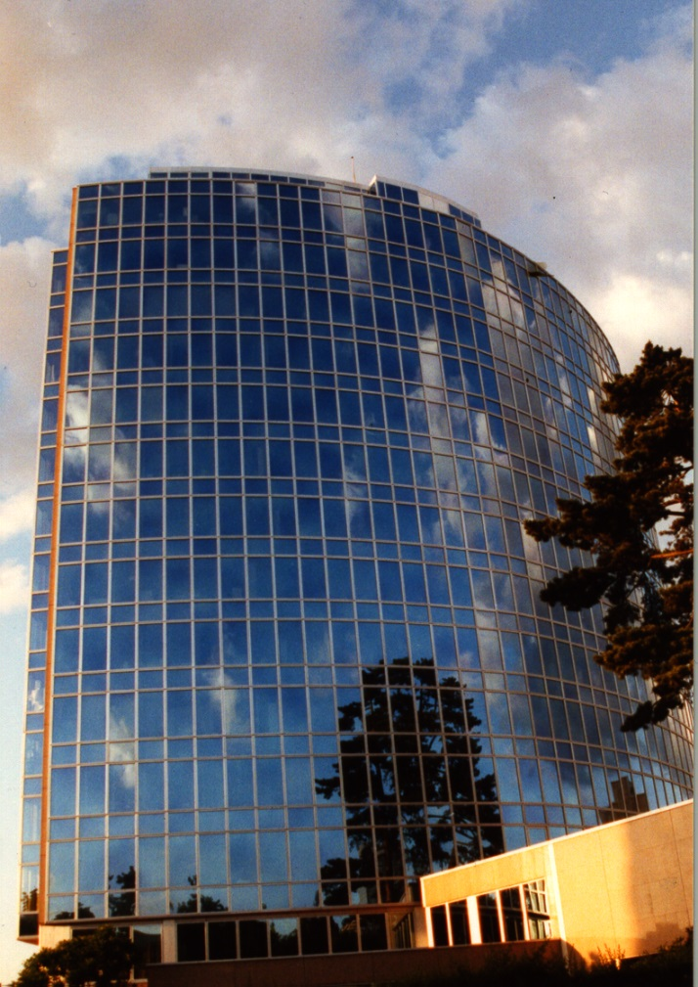
Basic Facts about WIPO
WIPO’s Mission:
To promote the protection of IP rights worldwide and extend the benefits of the international IP system to all member States
Status: An int’l intergovernmental organization
Member States: 183
Staff: 915 from 94 countries
Treaties Administered: 24
Decisions by: GA, CC, WIPO Conference
Guiding Principles: Transparency, Accountability, Consensus

Slide 65



INTRODUCTION TO COPYRIGHT IN INDIA
By:

Slide 66




Copyrights
An intellectual property right granted by a government to the author of an original literary, dramatic, musical, artistic, or other eligible creative work to an author, composer etc. (or his assignee) to print, publish and sell copies of his original work”
Statute-based, no registration necessary
Notes:
Copyright: A copyright is an intellectual property right granted by a government to the author of an original literary, dramatic, musical, artistic, or other eligible creative work. It gives the creator the exclusive right for a limited time to control how the work is published, reproduced, performed, or displayed.

Slide 67
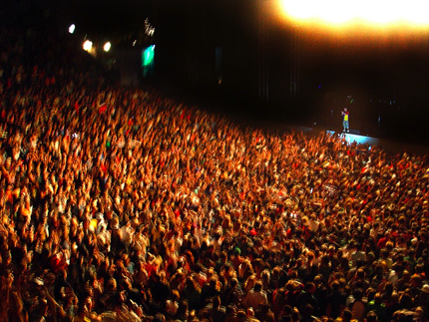
Why Copyright?
Fair Play: Reward creative efforts. “Thou shall not steal”
Exclusive rights for limited
time → Negative right:
prevent copying/reproduction
Copyright is necessary →
encourage dissemination of
copyrighted works = public interest

Slide 68
Copyright Subject Matter
The work concerned has to be
Original
Work of authorship
Fixed

Slide 69
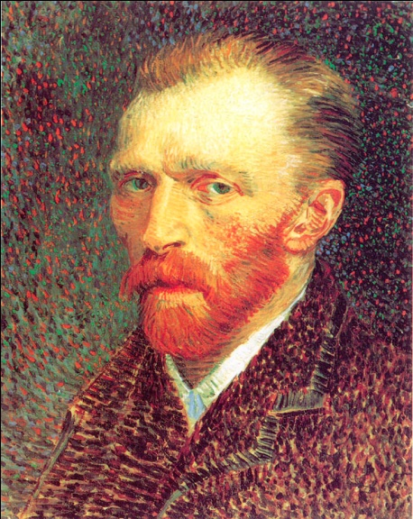


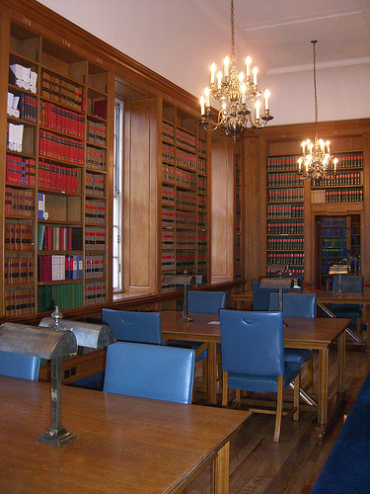
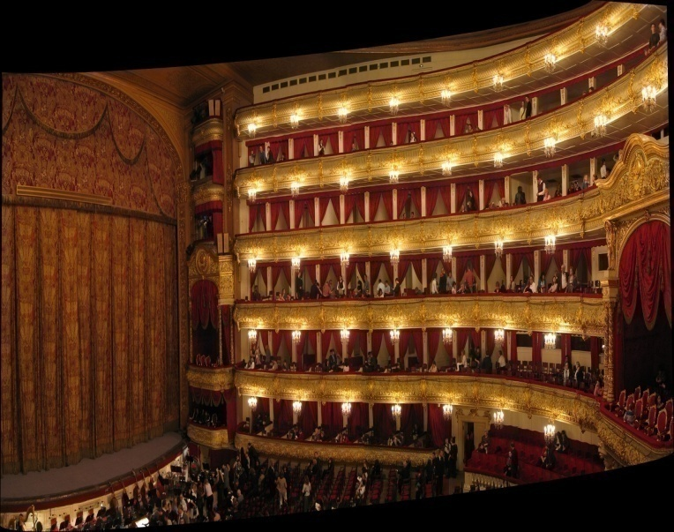
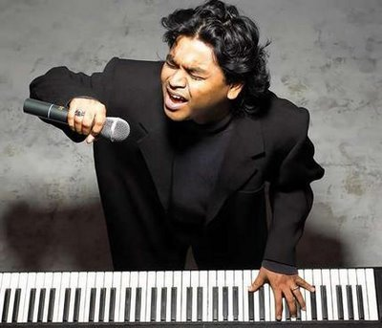

What Copyright Protects
Artistic Works
Original Literary, Dramatic, Musical and Artistic Works
Cinematograph Films
Sound Recordings
Photographs
Cinematograph Films

Slide 70

Literary Works
Novels, poems, short stories
Books on any subject
Computer programmes,
tables, computer databases
Song lyrics

Slide 71

Copyright Registration - Mandatory?
No. Automatic Acquisition of copyright
Comes into existence- On Creation
Certificate of registration -Prima facie evidence in dispute relating to ownership.

Slide 72

DURATION AND TERMS OF COPYRIGHT
Copyright protection lasts for 60-year from the year following the:
Literary work
Dramatic work
Musical work
Artistic work
Sound Recording
Cinematograph work
Death of Author
Date of Publication

Slide 73
PERFORMER’S and BROADCASTER’S RIGHTS
25 Years
Rights of a performer in a cinematograph film
Cessation of Rights after Consent
Broadcast:
Communication to the public by any means of:
Wireless diffusion or by wire.

Slide 74
Instruction for Filing copyright registration form Online:
Enter your valid User ID and Password to login. Click onto NewUser Registration, if you have not yet registered. Note down User ID and Password for future use. After login, click on to link “Click for online Copyright Registration”.

Slide 75
Instruction for Filing copyright registration form Online:
5.The online “Copyright Registration Form” is to be filled up in four steps Complete the Form XIV, then press SAVE button to Save entered details, and press Step 2 to move to Next Step. Fillup the Statement of Particulars, and then press SAVE button to Save entered details, and press Step 3/4 to move to Next step Fillup the Statement of Further particulars. This form is applicable for “LITERARY/ DRAMATIC, MUSICAL AND ARTISTIC” works, and then press SAVE button to Save entrered details, and press Step 4 to move to Next Step. Make the payment through Internet Payment gateway

Slide 76
Instruction for Filing copyright registration form Online:
6.After successful submission of the form, Diary Number will be generated (Please note it for future reference). 7.Please take hard copy(print) of “Acknowledgement Slip” and “Copyright Registration Report”, and send it by post to Copyright Division Department of Industrial Policy & Promotion, Ministry of Commerce and Industry Boudhik Sampada Bhawan, Plot No. 32, Sector 14, Dwarka, New Delhi-110075 Email Address: copyright@nic.in Telephone No.: 011-25301202

Slide 77
FEE CAN BE PAID BY POSTAL ODER /DEMAND DRAFT/ONLINE PAYMENT PAYABLE TO “REGISTRAR OF COPYRIGHTS, NEW DELHI”:
1. | For a license to republish a Literary, Dramatic, Musical or Artistic work (Sections 31, 31A,31B* and 32A) | Rs. 5,000/- per work
2. | For a license to communicate an any work to the public by Broadcast(Section 31(1)(b)) | Rs. 40,000/- per applicant/per sataton
3. | For an application for registration or copyright in a:
 | (a)Literary, Dramatic, Musical or Artistic work | Rs. 500/- per work
 | (b)Provided that in respect of a Literary or Artistic work which is used or is capable of being used in relation to any goods or services (Section 45) | Rs. 2,000/- per work
4. | For an application for change in particulars of copyright entered in the Register of Copyrights in respect of a:
 | (a)Literary, Dramatic, Musical or Artistic work | Rs. 200/- per work
 | (b)Provided that in respect of a literary or Artistic work which is used or is capable of being used in relation to any goods or services (Section 45) | Rs. 1,000/- per work
5. | For an application for registration of Copyright in a Cinematograph Film (Section 45) | Rs. 5,000/- per work
6. | For an application for registration of copyright in a Sound Recording (Section 45) | Rs. 2,000/- per work
7. | For taking extracts from the indexes (Section 47) | Rs. 500/- per work

Slide 78
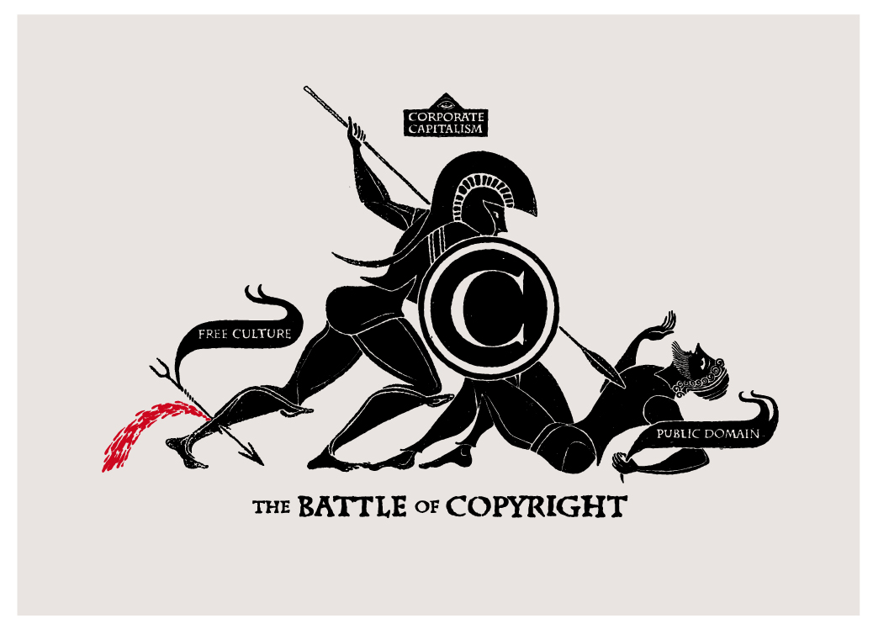

Slide 79
General Principles for Use
for the purpose of research or private study,
for criticism or review,
for reporting current events,
in connection with judicial proceeding,
performance by an amateur club or society if the performance is given to a non-paying audience, and
the making of sound recordings of literary, dramatic or musical works under certain conditions.

Slide 80

Remedies for Copyright Infringement
Strengthening Copyright, Enhancing the Reach of the Law

Slide 81
Copyright Examples

Slide 82
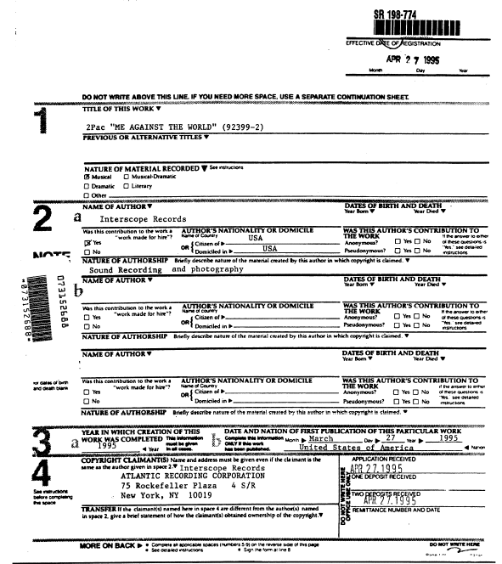
2Pac – “Me Against The World”

Slide 83
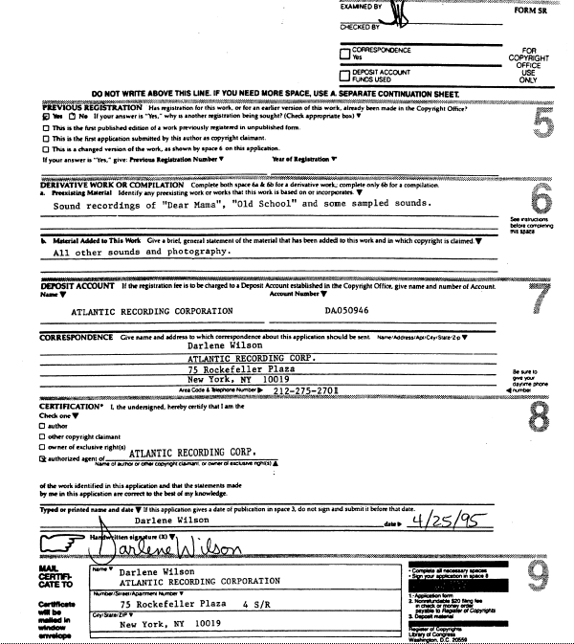
2Pac – “Me Against The World”

Slide 84
Importance of Patent Information in Business Development
Advantages of protecting intellectual property
Intellectual property (IP) rights don't protect ideas or concepts. They protect genuine business assets that can be vital to your products or services, or the success and profitability of your business.
There are many advantages to securing your intellectual property rights. For example, protecting your IP can help you:
Enhance the market value of your business - IP can generate income for your business through licensing, sale or commercialization of protected products or services. This can, in turn, improve your market share or raise your profits. In case of sale, merger or acquisition, having registered and protected IP assets can raise the value of your business.
Turn ideas into profit-making assets - Ideas on their own have little value. However, IP can help you to turn ideas into commercially successful products and services. Licensing your patents or copyright, for example, can lead to a steady stream of royalties and additional income that can boost your business' bottom line.

Slide 85
Importance of Patent Information in Business Development
Market your business’ products and services - IP is essential in creating an image for your business. Think trade marks, logos or the design of your products. IP can help you differentiate your products and services in the market and promote them to your customers.
Access or raise finance for your business - You can monetise your IP assets through sale, licensing or using them as collateral for debt financing. As well as this, you can use your IP as an advantage when applying for public or government funding, eg grants, subsidies or loans.
Enhance export opportunities for your business - IP can increase your competitiveness in export markets. You can use brands and designs to market goods and services abroad, seek franchising agreements with overseas companies, or export your patented products.
While some IP rights are automatic, others will need formal application and registration before you can claim them. Read more about the different types of intellectual property and the importance of protecting intellectual property.

Slide 86
Case Study
Importance of Patent Information in Business Development

Slide 87
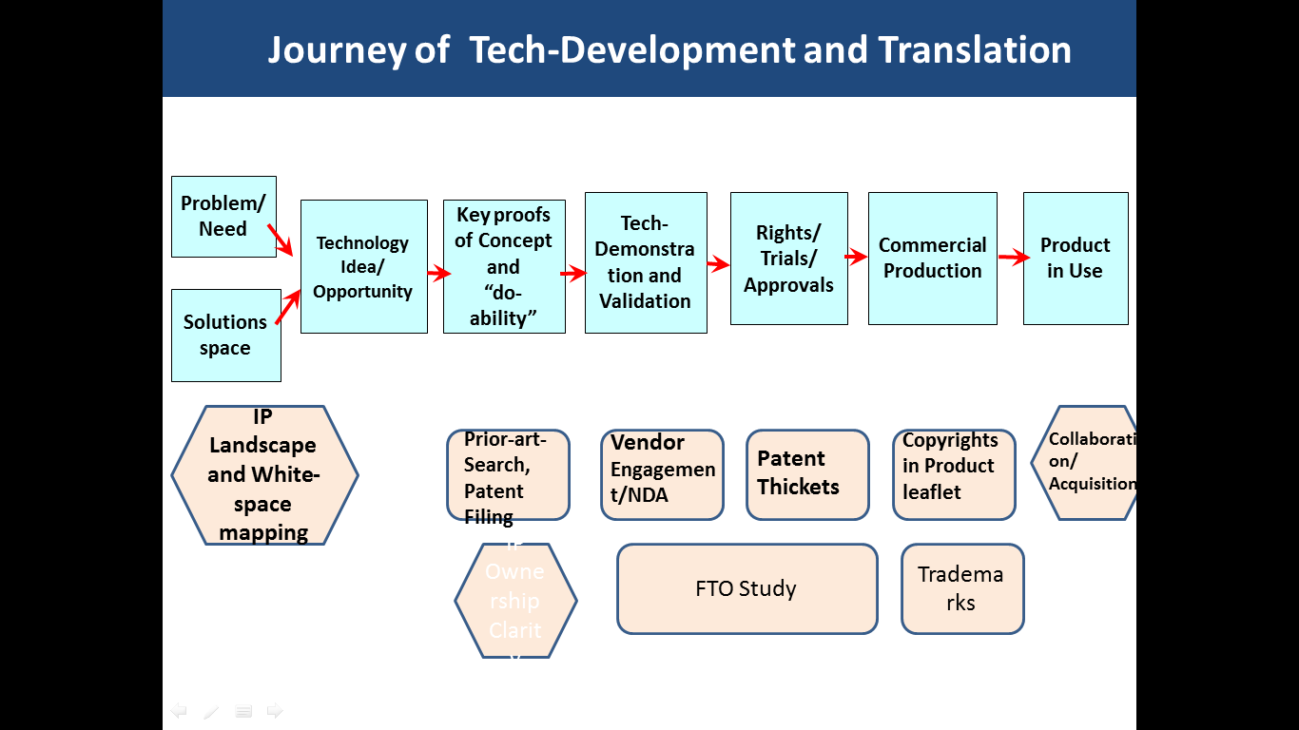

Journey of Tech-Development and Translation
------------------------------------------------------------------------------------
-----------------------------------------------------------------------------------
IDENTIFY
INVENT
IMPLEMENT
IP Licensing /Acquisition
Third Party Engagement/ NDA
Valuation
Trademark
IP Infringement watch ,
Invalidation Opposition
IP Landscape &
White-space mapping
Patent Filing
Patent Portfolio
IP Ownership/Commercialisation Clarity
Competitor Analysis
FTO Analysis
Copyrights Product Leaflet
Industrial Design

Slide 88
What is Landscaping??
IP Landscaping: Research process that creates an overview of the patents that are pending or in place in a particular area.
Landscape Analysis: White Space Mapping
IP
Technology
Market
Competitive Landscape
Key players/competitors
Platform technologies
Potential partners (in- & out-
license)
Pricing considerations
Mapping of Existing Patents
“Evaluation of White space”
Market size
Trends
Demand
Jurisdictions
Avoid reinventing the wheels..........

Slide 89




Strategize
Strategize-Early on…..
Go-ahead
Reject/ Abandon
Work around
In-license
Early identification and avoidance of potentially blocking IP rights of others before substantial investment in R&D, manufacturing, and marketing

Slide 90
What is Freedom-to-Operate (FTO) ??
What is Freedom-to-Operate?
To ensure that your product does not infringe the Intellectual Property (IP)
rights of others.
Freedom-to-operate searches identify potential patent barriers to the
commercialization of products or technologies.
Involves searching the claims language of third-party in-force patents
FTO search is a dynamic on-going analysis
Notes:
90

Slide 91
Case Studies
Building and Strengthening IP Portfolio around Product
Strategic IP Protection & Brand Building-Financial Rewards
Robust Agreements -Vendor Engagement
Clarity on IP Ownership and Commercialization Rights
Technology Valuation for Adding Value to IP
BCIL- Providing hand-holding support to Entrepreneurs –SIB
1
2
3
4
5
6

Slide 92
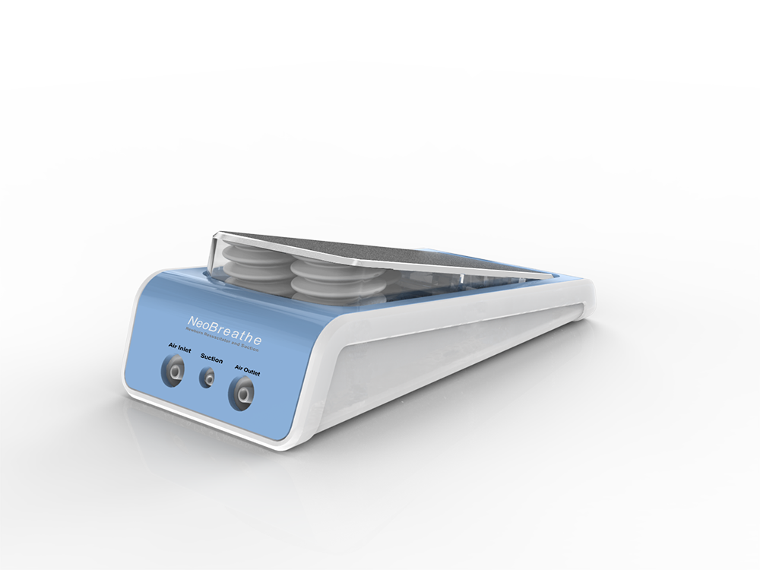
IP Portfolio
“IP Portfolio- Medical Devices”
Patent
1814/DEL/2012
4049/DEL/2015
PCT/IB2016/001746
Novel & Inventive
Brand Name
Copyright
Trademark
NEOBREATHE™
Package Insert/
Information Leaflet
External Appearance
Trade Secret
Know-how
Confidential Info.&
Undisclosed Tech
Design
No. 275868

Slide 93
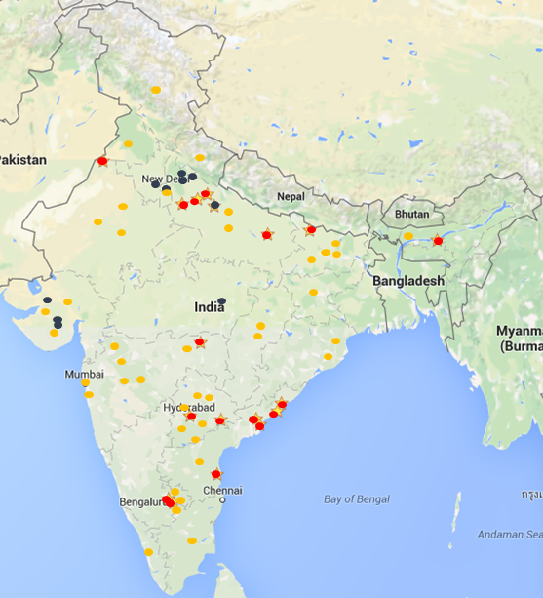
Current Status, limited market release
“So clever! Why didn’t I
think of this before!”
“I feel like have 2 extra hands, I need this today, not 5 months later!”
Dr. Atul Agarwal, MD
District Instructor, NRP, Bareilly
(Customer)
Dr. Manuel Sanchez Luna,
President, The European Union of Neonatal
and Perinatal Societies, Spain
In use (limited market release site)
Pre-orders
Written sales enquiries
“Pilot has gone well. We’ll
likely need 1500 units –
1 for each birthing center.
“I need 2 more urgently!”
Dr. Gaurav Agarwal,
HOD Paediatrics, KOSMOS Hospital,
Moradabad
(Customer)
Dr. Rajshree Bajaj
Deputy Director Child Health,
National Health Mission,
Madhya Pradesh
“This single device provides everything Pediatricians currently miss in resuscitation”
“My JRs in the OT are loving it!”
Dr. Surender Bisht,
SDN District Hospital, East Delhi
National Level NRP Trainer
(Customer)
Dr. Sandeep Gupta,
Director, Delhi Newborn center, one of India’s largest NICUs

Slide 94



Slide 95
Case Studies
Building and Strengthening IP Portfolio around Product
Strategic IP Protection & Brand Building-Huge Financial Rewards
Robust Agreements -Vendor Engagement
Clarity on IP Ownership and Commercialization Rights
Technology Valuation for Striking a Good Deal
BCIL- Providing hand-holding support to Entrepreneurs –SIB
1
2
3
4
5
6

Slide 96
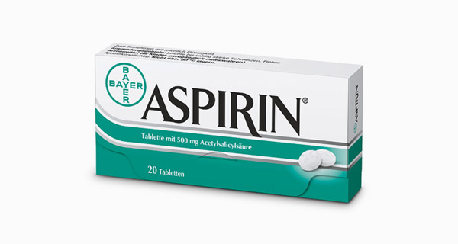
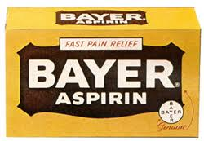
Aspirin: Strategic IP Protection by Bayer
Aspirin –Developed by Bayer in 1897
Drug patented by Bayer in 1899
Bayer protected the Trademark-Aspirin
Promoted, heavily advertised Trademark –Built Brand Value
Patent Expired
Bayer continued to reap benefit from sales through established trademark Aspirin

Slide 97
Case Studies
Building and Strengthening IP Portfolio around Product
Strategic IP Protection & Brand Building-Huge Financial Rewards
Robust Agreements -Vendor Engagement
Clarity on IP Ownership and Commercialization Rights
Technology Valuation for Striking a Good Deal
BCIL- Providing hand-holding support to Entrepreneurs –SIB
1
2
3
4
5
6

Slide 98
Ensuring Confidentiality during Vendor Engagements
Lunar Group, USA
Industrial Design Firm
BCIL
Uttejana Pvt. Ltd, Bangalore
Engineering design/testing
UL Group, Bangalore
Regulatory Consultancy
Agreements for contractual engagement drafted to ensure maintenance of:
IP Ownership
Inventorship
Confidentiality
Prevention of reverse engineering

Slide 99
Case Studies
Building and Strengthening IP Portfolio around Product
Strategic IP Protection & Brand Building-Huge Financial Rewards
Robust Agreements -Vendor Engagement
Clarity on IP Ownership and Commercialization Rights
Technology Valuation for Striking a Good Deal
BCIL- Providing hand-holding support to Entrepreneurs –SIB
1
2
3
4
5
6

Slide 100


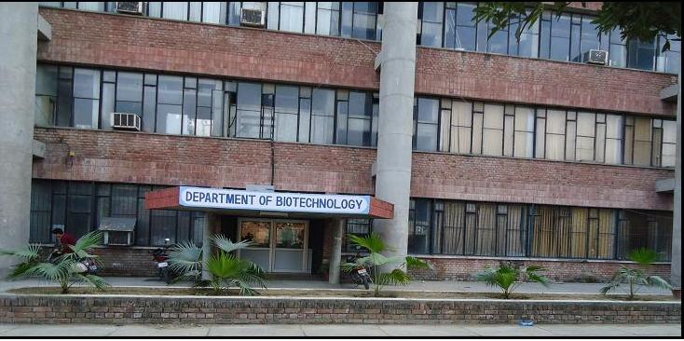
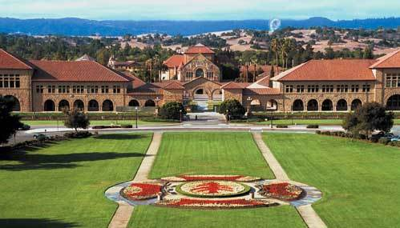
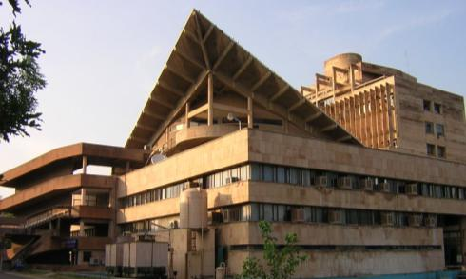
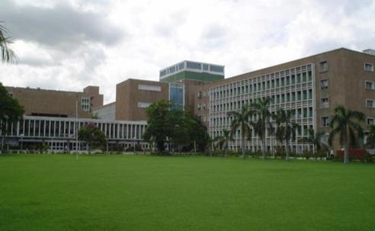


Enabling Ownership Clarity of IP
for Commercialization
Four Collaborators-One Program
Who owns the IP
Joint IP
Commercialization Issues
Department of Biotechnology
Stanford University, CA
IIT, New Delhi
AIIMS, New Delhi
19 Technologies transferred,
Five products commercially launched
Ownership by One Neutral Body
Commercialization rights to BCIL

Slide 101
Case Studies
Building and Strengthening IP Portfolio around Product
Strategic IP Protection & Brand Building-Huge Financial Rewards
Robust Agreements -Vendor Engagement
Clarity on IP Ownership and Commercialization Rights
Technology Valuation for Striking a Good Deal
BCIL- Providing hand-holding support to Entrepreneurs –SIB
1
2
3
4
5
6

Slide 102


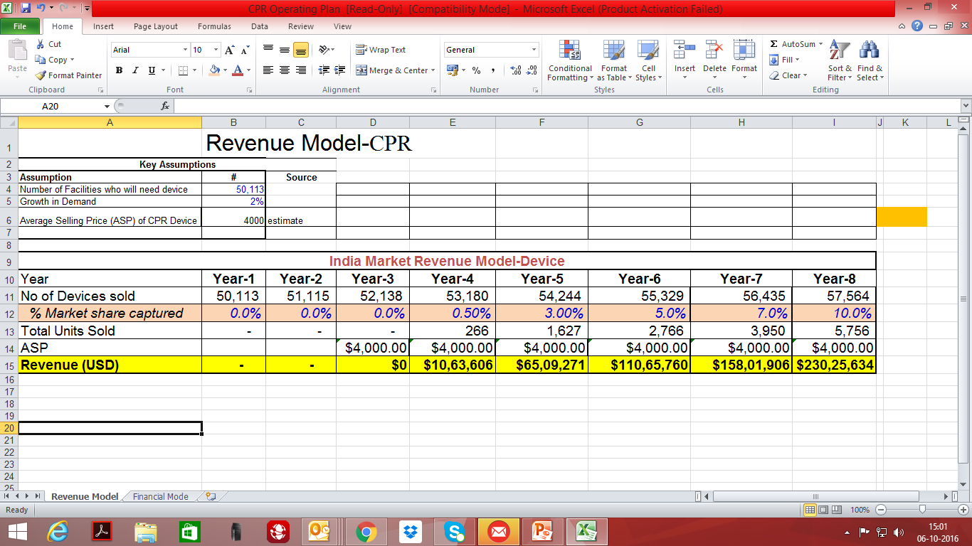

“Technology Valuation” for Realising
Appropriate Deal Value
Technology
An Emergency Medical Device for Cardiac Patients, developed at AIIMS
Class- III, Technology Intensive device
IP protected in India, Europe, USA, Israel and Australia
Key Assumptions
Assumption | #
Number of Hospitals, who will need device | 50,113
Growth in Demand | 2%
Average Selling Price(ASP) per device | 4000 USD

Slide 103


Valuation contd….
Expected revenue from product sales from 5 year of Sales: Rs. 373.53 Crores
Licensing fee proposed 3% of the gross sales Rs. 11.20 Crores (Upfront payment and royalty)
Key outcomes
Valuation helped in negotiations backed with Market Data and Expected Revenue Stream
Very Good Licensing Royalty Benefits Expected

Slide 104
Case Studies
Building and Strengthening IP Portfolio around Product
Strategic IP Protection & Brand Building-Huge Financial Rewards
Robust Agreements -Vendor Engagement
Clarity on IP Ownership and Commercialization Rights
Technology Valuation for Adding Value to IP
BCIL- Providing hand-holding support to Entrepreneurs –SIB
1
2
3
4
5
6

Slide 105


Tech-Development and Translation|| Role of BCIL
Solutions space
BCIL
Drive Strategic Collaboration
IP Evaluation and Filings
Marketing , Identification of Potential Licensees
Negotiations and Technology Transfer
Post-Transfer Monitoring
Valuation and Pricing
Revenue Collection and Disbursal
Drafting Contracts/Agreements
Licensing of Technologies

Slide 106
FI device-Role of IP in Entrepreneurial Journey
------------------------------------------------------------------------------------
------------------------------------------------------------------------------------
Consure Medical Entrepreneurial Journey
Patent Landscape Mapping ,
Prior Art Study
Patent Filing,
Vendor Engagement
Identifying USP
Built IP portfolio,
FTO Analysis
Patents
Marketing Tie-ups, IP Watch
Developed different product variants
No Indwelling Devices for long term management of Stools
Patent Filing around USP
Industrial Design
Trademark
USA, Canada
Japan, Israel
Singapore
India, Australia
Europe
Patents Filed
FTO found in indwelling FI devices
Europe based-NDA AND Contract
Market positioning
Key sales in India ad USA
IP Watch

Slide 107

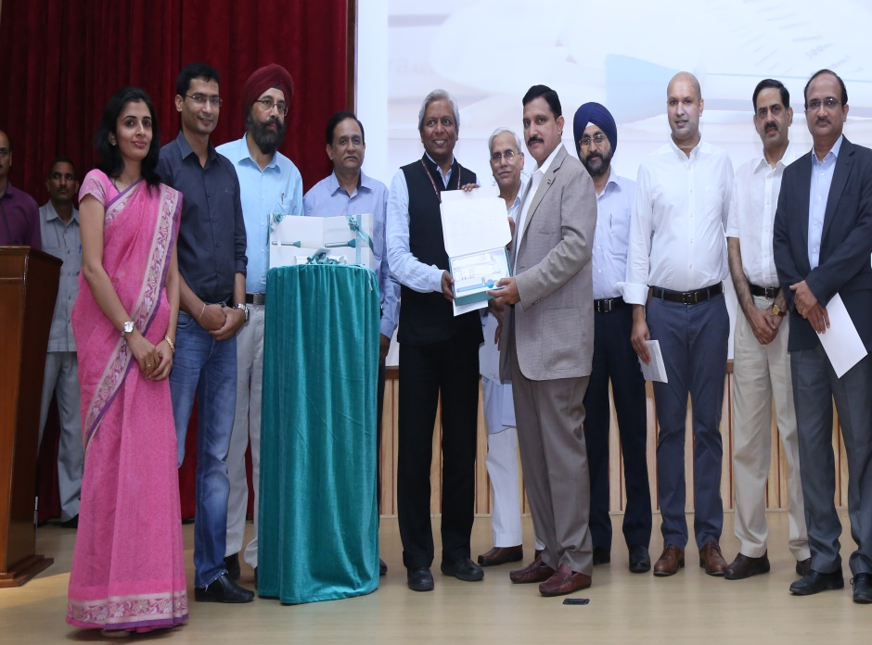
FI Entrepreneurial Journey- Role of BCIL
FI Device- Product Launching
Product Launch In the presence of Honourable Minister of State for S&T Shri Y.S. Choudhary and Secretary DBT Dr.K VIjayRaghavan

Slide 108
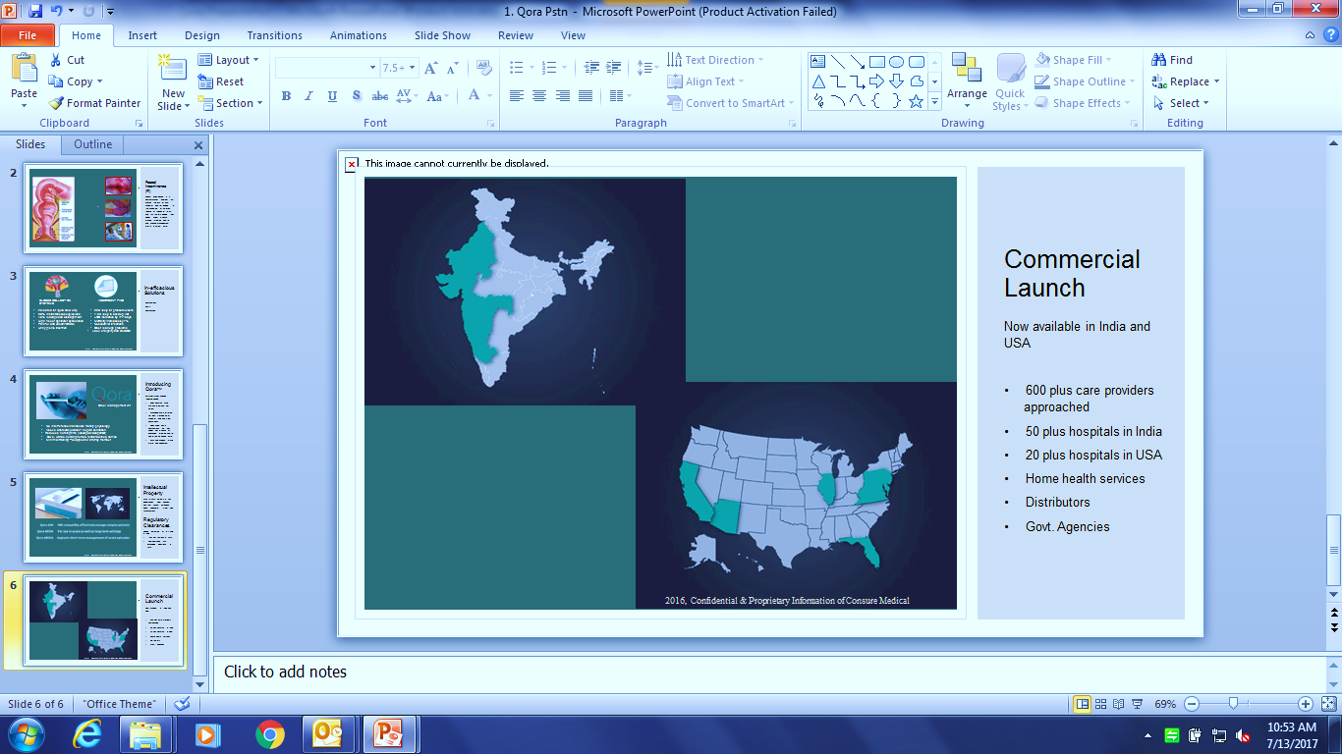

Slide 109
1. What is meant by Intellectual Property? How is different from intellectual property rights?
2. Why does intellectual property need to be promoted and protected?
3. What is a patent? Explain the elements of patentability?
4. An invention may satisfy the condition of novelty, inventiveness and usefulness but it may not qualify for a patent. Discuss.
5. What are the steps involved in Trademark registration process? Explain with help of a FlowChart.
6. What are the steps involved in copyrights registration process? Explain with help of a FlowChart.
7. What are the Stages from filing to grant of a patent ? Explain along with Time Deadline involved with the help of a FlowChat.
8. What is a Copyright? Write the steps of Filing copyright registration form Online.
9. Discuss the Importance of Patent Information in Business Development.
10. write Short note on 1 Litigation 2. Licensing 3 Mediation 4 Arbitration 5 IP Landscaping
6 Anticipations 7 Specifications

Slide 110



.24044@lpu.co.in

